Slide 1

Voice2Image synthesis
BMS College of Engineering
Department of Information Science and Engineering
Review - II
Gururaja H.S
Assistant Professor

Slide 2
Problem Identification/Objectives
Problem definition
Voice-to-Image synthesis
Vision is one of the most essential ways in which humans communicate, interact, experience, and learn about the world around them. AI systems that can generate images and video for human users have applications ranging from education and entertainment to that of the creative arts. Such systems also have the potential to serve as accessibility tools for the physically impaired. A system that can follow speech- or text-based instructions and then perform a corresponding image generation task could improve this accessibility substantially. These benefits can easily extend to other domains of image generation such as gaming, animation, creating visual teaching material.
Objectives (Should be Achievable and Feasible)
Build a Speech recognition system that can generate textual data
GAN model that can translate textual captions into the corresponding image to a high degree of accuracy
Integrate the two systems to form a single seamless Voice-to-Image synthesis model

Slide 3
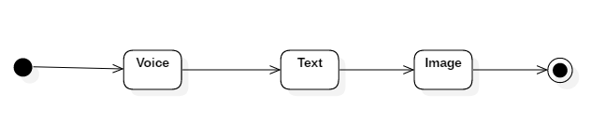
High level Diagram
Speech waveforms are given as input to the Voice-to-Text model that in turn generates the corresponding text.
The text is then passed to the Voice-to-Text GAN model, specifically the Generator model, that generates multiple images from the text.

Slide 4
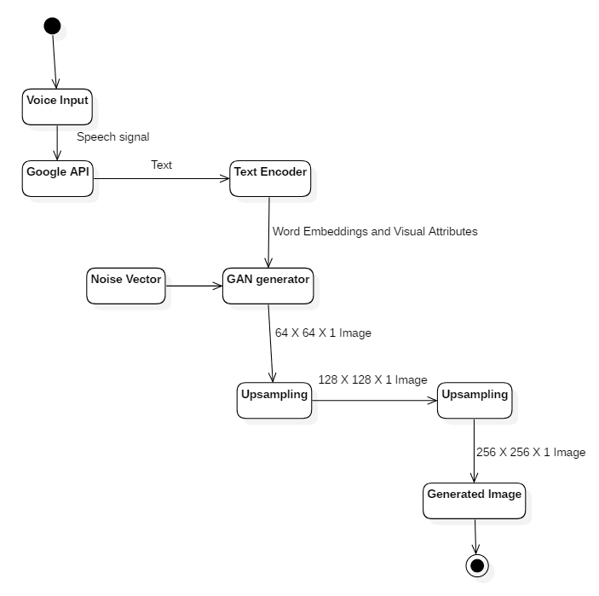
Data Flow Diagram

Slide 5
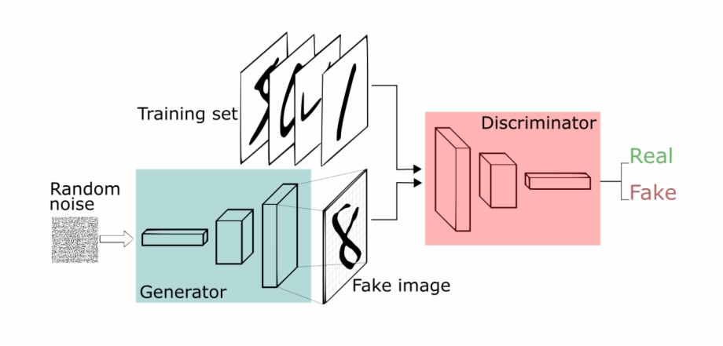
System Design & Technology Stack
Concept of Generative Adversial Networks (GANs)
Discriminative algorithms are those whose main aim is to classify the input data, by mapping input features of the data to labels.
Generative algorithms on the other hands work in a totally different manner as it tries to generate the input data by mimicking the distribution of the input data.

Slide 6
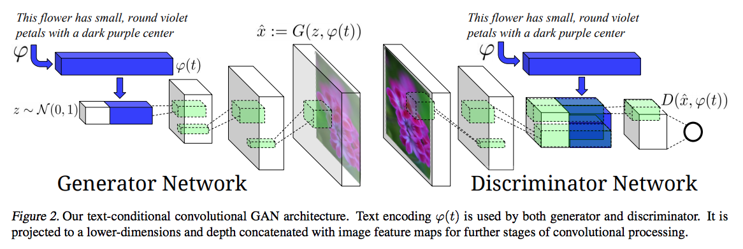
Algorithm details (Text-to-Image)
1024x1 text embeddings convoluted to 128x1 and concatenated with 100x1 noise vector
Discrimator side, reshaped to 4x4 and depth wise concatenated with image representation obtained after multiple convolutions and spatial resolution
DCGAN is used for up-sampling the image to higher resolutions
Image encoder is derived from GoogleNet, that reduces image to a 1024x1 vector
Objective function is to minimize the loss between text and image representation
Key role of the discriminator is to predict if the image and text pair differ or not

Slide 7
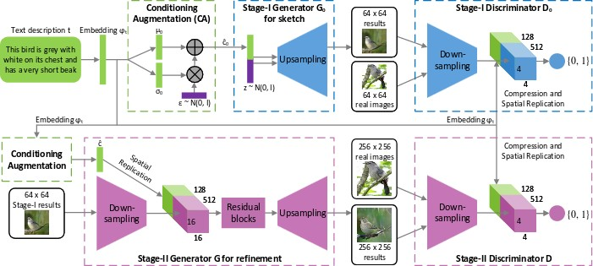
Algorithm details (Text-to-Image)
StackGAN
The primitive colours and shapes conditioned on the text description yielding a low resolution image
The defects in the image are corrected by downsampling the stage-1 results and fine tuning by reading the text description again

Slide 8
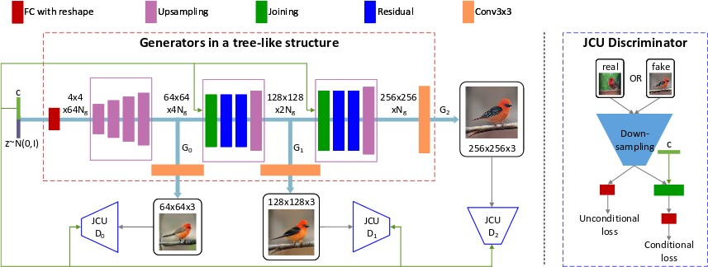
Algorithm details (Text-to-Image)
StackGAN++
Consists of 3 stages instead of 2 from its predecessor.
It consists of multiple generators and discriminators arranged in a tree-like structure; images at multiple scales corresponding to the same scene are generated from different branches of the tree.

Slide 9
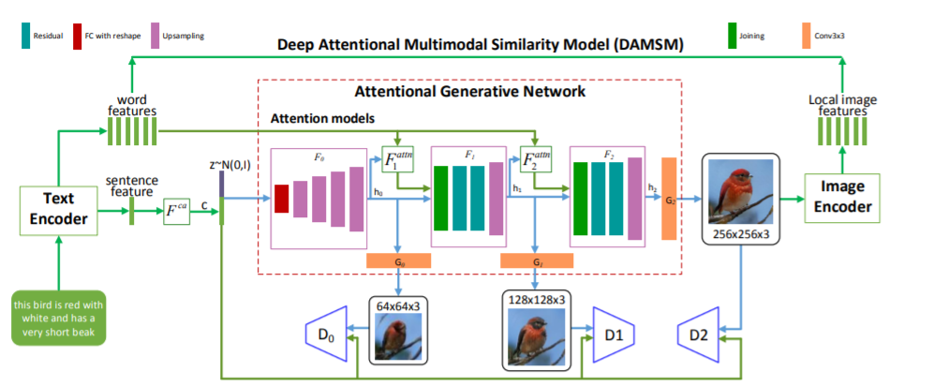
Low level diagram (Text-to-Image)
Vector representations of the text is created using LSTMs or CNNs for both sentence and word level.
Vector representation of the image is created by using multilayer CNNs that capture the features of the text with word level features.
The two representations are measured using a deep attentional multimodal similarity metric to calculate loss with which the model is trained.

Slide 10
Algorithm details
Feature extraction is done on the input waveform and stored as binary archives.
Labels are derived from forced alignment procedure between the speech features and the sequence of context-dependent phone states computed by Kaldi.
Each minibatch is processed by DNN, that takes as input the features and as outputs a set of posterior probabilities.
The decoder merges the acoustic scores with the language probabilities and tries to retrieve the sequence of words uttered in the speech signal

Slide 11
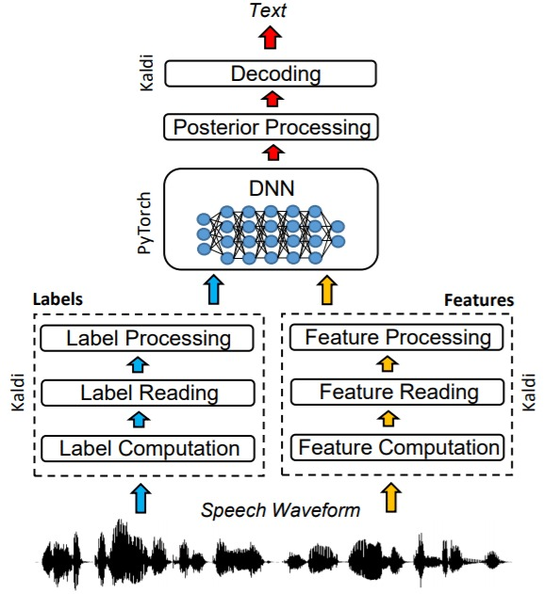
Low level diagram (Voice-to-Text)

Slide 12
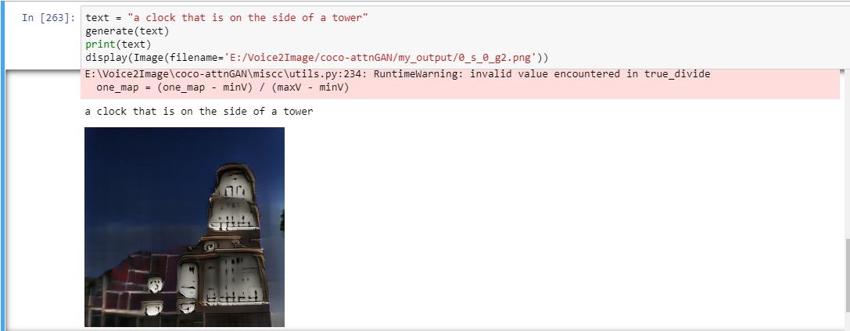
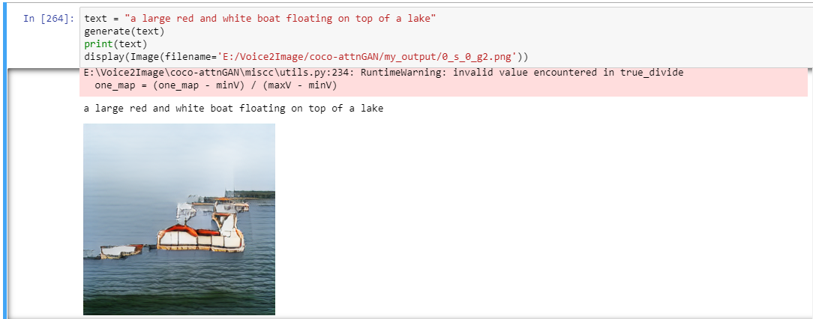
Results (MOC)
A clock that is on the side of a tower
A large red and white boat floating on top of a lake

Slide 13
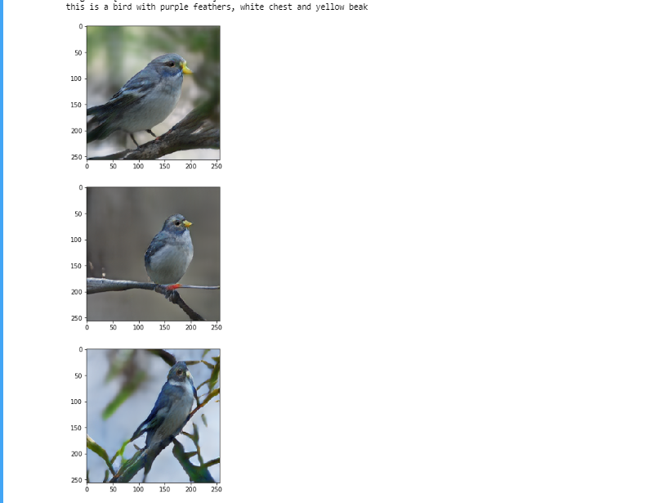
Results (MOC)

Slide 14
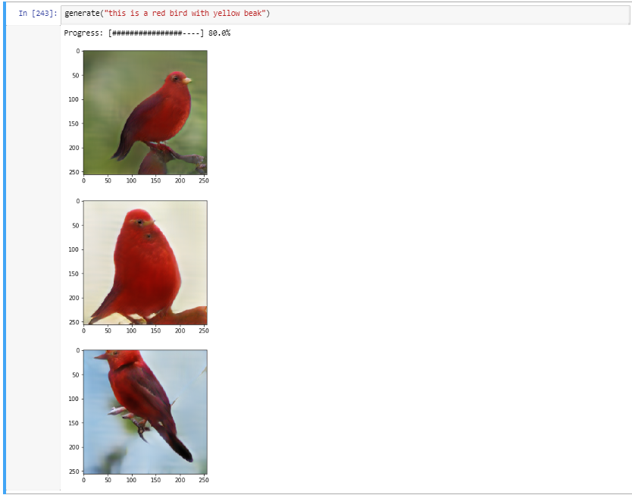
Results (MOC)

Slide 15
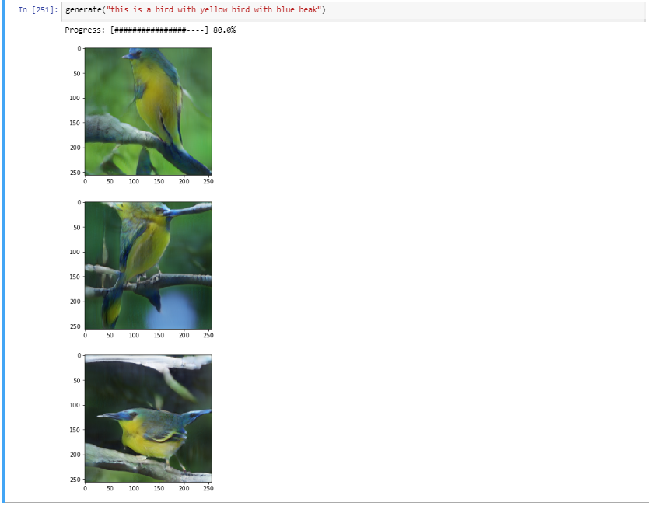
Results (MOC)

Slide 16
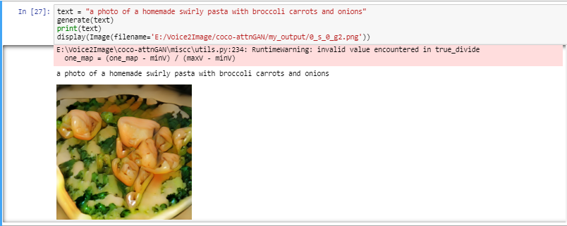
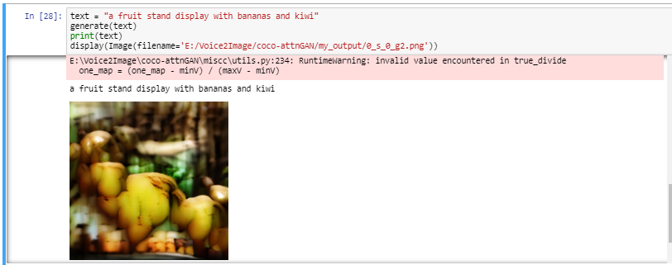
Results (MOC)

Slide 17
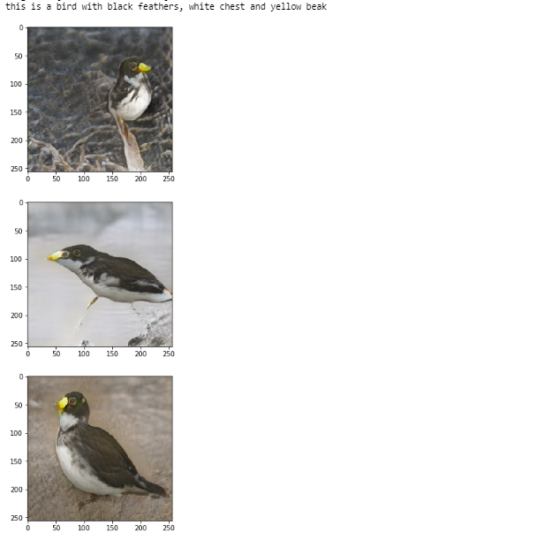
Results (MOC)

Slide 18
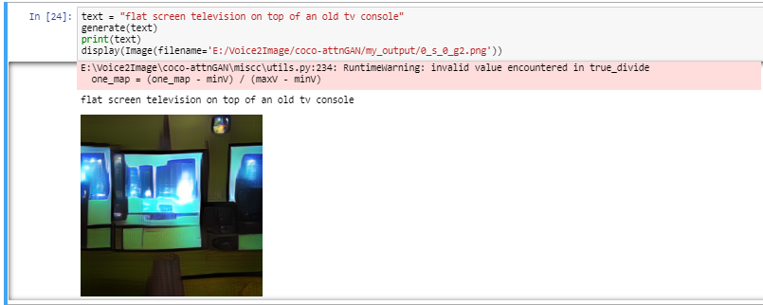
Results (MOC)

Slide 19
Current Project Work Status
Objectives
Educational tutoring where continuous rendering of images are required while explaining a concept.
Crime surveillance where a crime scene can be recreated with factual data of the plausible events that have occurred.
Application in Computer aided designing by rendering objects by spoken word.
Innovation
Combining two novel technologies to create an integrated model that performs image synthesis from speech that has not been created as of yet.
Implementation
Sample voice to text code has been drawn out

